Slide 1
CS499 - Open Source software development
Lecture #02: Basics about open source software
Dr. Igor Steinmacher
e-mail: Igor.Steinmacher@nau.edu
Twitter: @igorsteinmacher

Slide 2


Slide 3
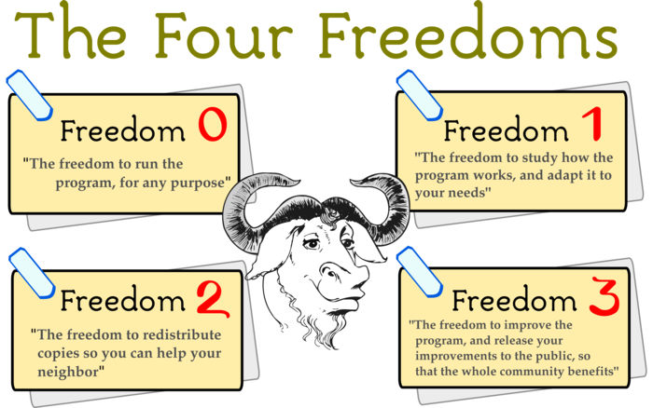

Slide 4

Questions
What is Open Source about?
Notes:
c

Slide 5
Questions
What is Open Source about?
Price?
Notes:
c

Slide 6
Questions
What is Open Source about?
Price?
License?
Notes:
c

Slide 7
Questions
What is Open Source about?
Price?
License?
Social Movement?
Notes:
c

Slide 8
Questions
What is Open Source about?
Price?
License?
Social Movement?
Hobby?
Notes:
c

Slide 9
Questions
What is Open Source about?
Price?
License?
Social Movement?
Hobby?
Market trend?
Notes:
c

Slide 10

Do you use Open Source?

Slide 11
More Questions
Software vs. hardware: what’s the difference?
Engineering vs. Software Engineering
Tool vs. Knowledge
Product vs. Service

Slide 12

So…
Open Source is about…
Freedom
License
Code as a way to share knowledge
Community!

Slide 13

A little bit of history

Slide 14
Pre-historic…
Commercial settings:
software is usually part of a bigger solution (consulting, hardware, maintenance, etc.)
not a solution per se
Academic settings:
Software is informally shared as a way to share knowledge
Hobbyists
Hacking for fun
Garage programmers community

Slide 15
And the History…
1976 – Bill Gates’ “Open Letter to Hobbyists”
Copyright infringement + commercial power
“Will quality software be written for the hobby market?”
“One thing you do do is prevent good software from being written.”
1980 – Stallman problem with Xerox printer
Stallman refused access to the source code for the printer driver
1981 – IBM signs a deal with “Micro-Soft”
MS-DOS embedded in each and every IBM machine
1984 – Stallman launches GNU project
1985 – Free Software Foundation (FSF) was formed to house funding for the GNU Project

Slide 16
And the History…
1991 – Linus Torvalds creates (or kicks off) Linux
Personal/informal project
Message to a newsgroup at Usenet
V 1.0.0 released in 1994 with 170+ KLoC
1995 – Internet Boom
Linux is distributed in large-scale
1997 – Eric Raymond writes “The Cathedral and the Bazaar”
Advantages of Open Source
Development in a decentralized way

Slide 17
And the History…
1998 – Netscape open-sourced
Fight with MS Explorer?
1998 – Eric Raymond, Linus Torvalds and others launch the Open Source Initiative (OSI)
Technical reasons to Open-source
Use of “Open Source” instead of “Free software”
1999 – Sourceforge is launched
2000 – OpenOffice is launched
2001 – IBM invests $1 billion on Linux

Slide 18
And the History…
2003 – SCO sues IBM
2005 – Sun launches Solaris 10 as Open Source
2007 – Sun launches JDK under GPL
GitHub launches in 2008
GitHub BOOM ~2010–2011 (2 million repos in 2011)
… MANY COMPANIES JOINING

Slide 19
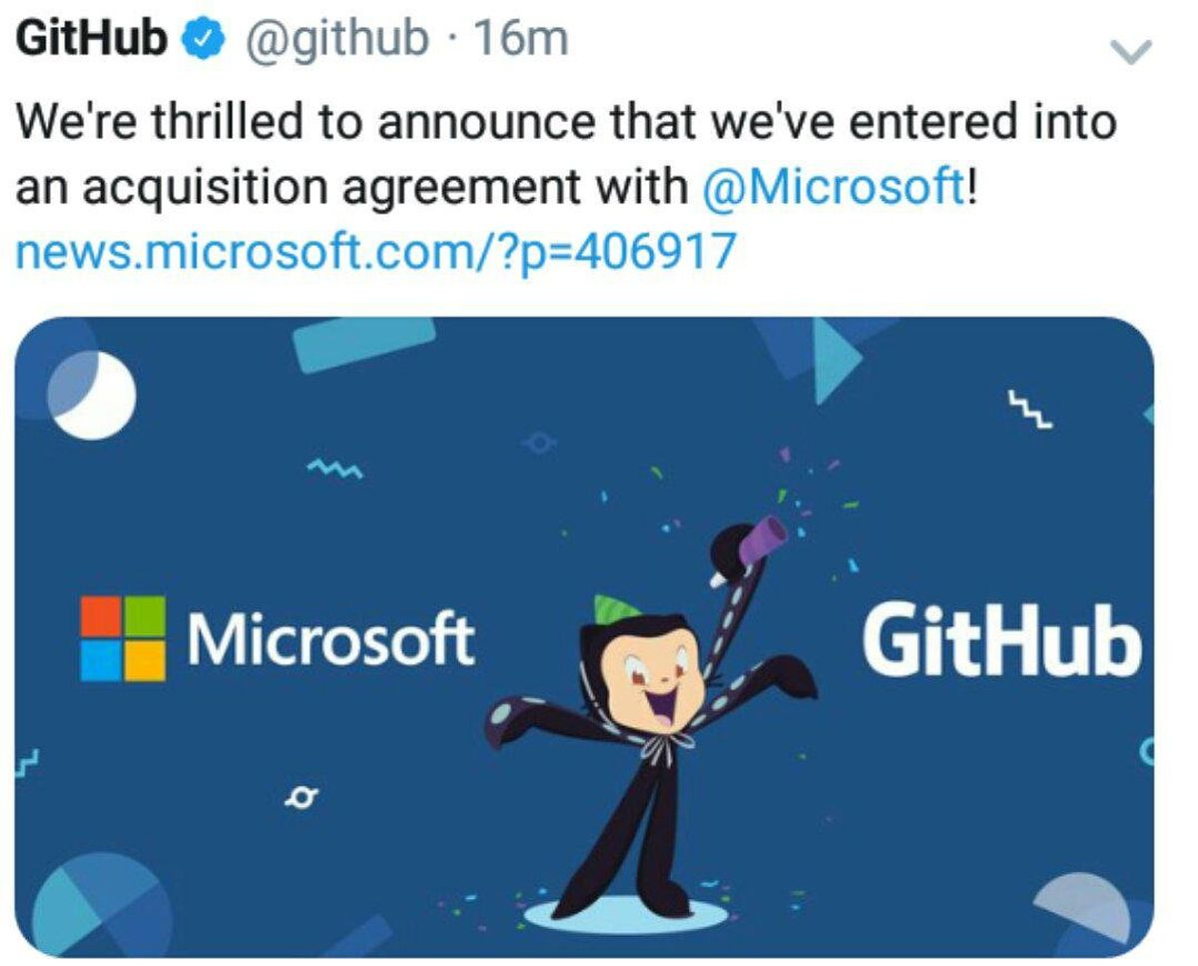
And the History…
2003 – SCO sues IBM
2005 – Sun launches Solaris 10 as Open Source
2007 – Sun launches JDK under GPL
GitHub launches in 2008
GitHub BOOM ~2010–2011 (2 million repos in 2011)
… MANY COMPANIES JOINING

Slide 20
Why???

Slide 21
Why Open Source?
Incentive to collaboration → human relationship
Technical education
“Low-cost” access to “high-end” technology
Decentralizes the “power” of the software
Government → knowledge and transparency

Slide 22
Why Open Source?
Less duplicated code (and cost)
Less bugs → More quality
“Given enough eye-balls all bugs are shallow”
Customization and improvements
Competition for support

Slide 23
“Problems”
Quality assessment of the solutions
Sustainability
“Intellectual property”, trademarks, and patents
Reputation (FUD)

Slide 24
Final facts

Slide 25
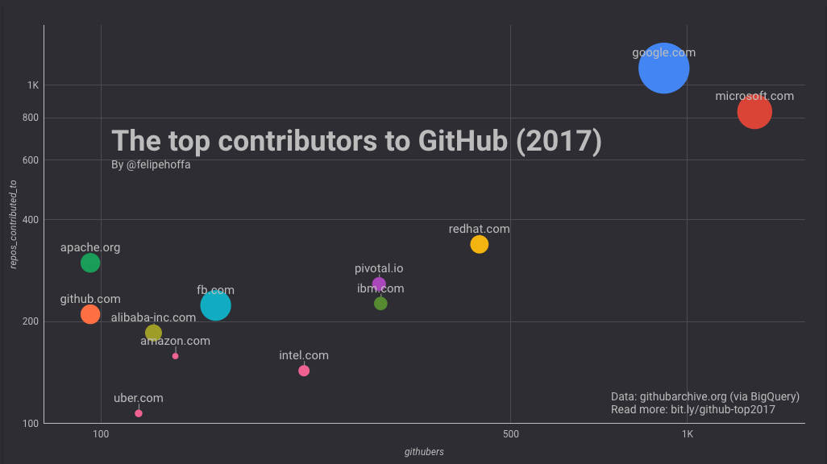
And… Open source leads the way

Slide 26
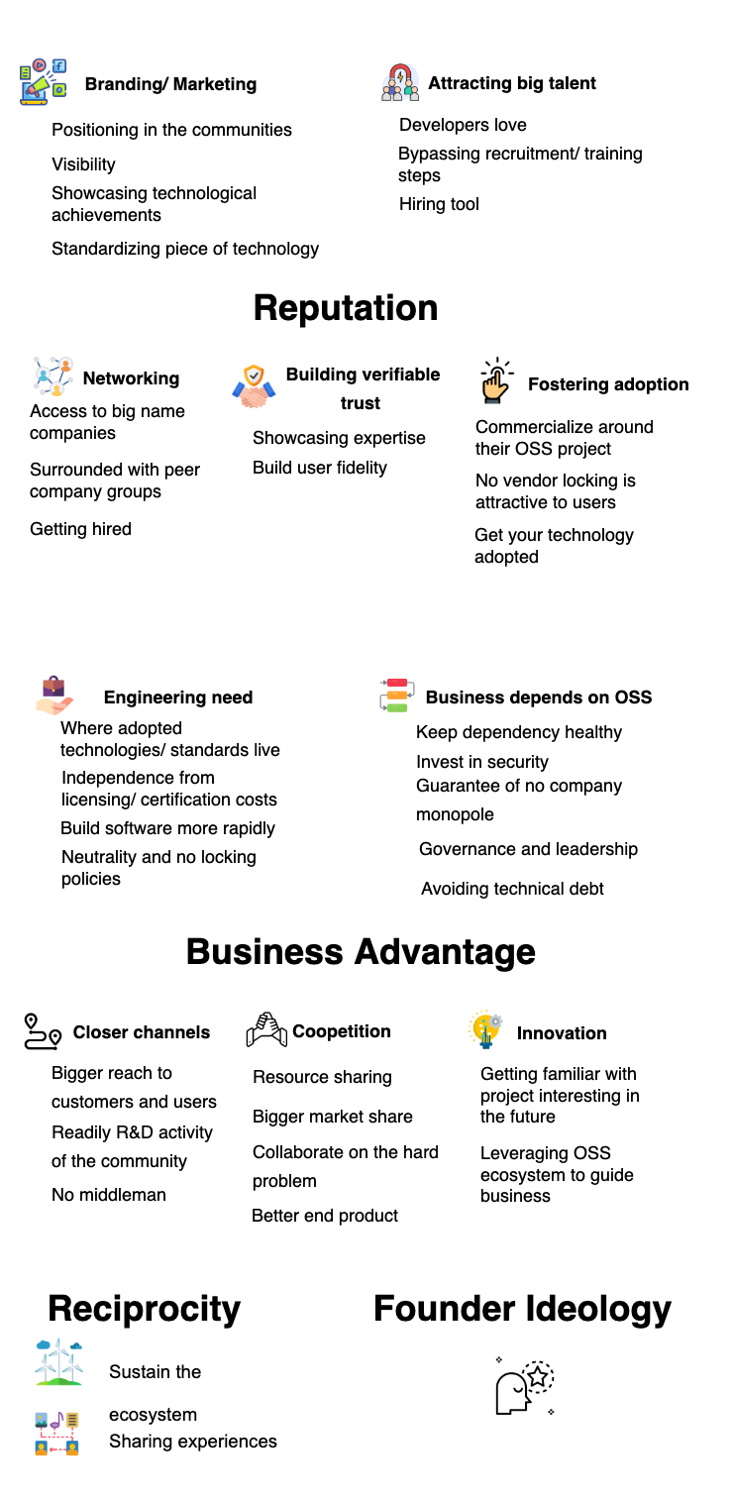
Why are companies joining OSS?
GUIZANI, M. et al. Rules of Engagement: Why and How Companies Participate in OSS. ICSE 2023

Slide 27
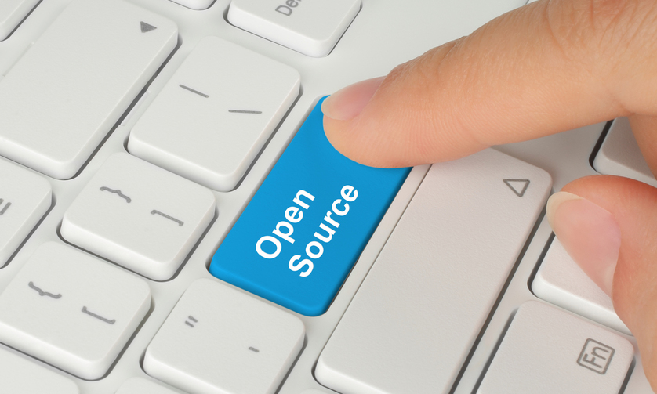
Why are companies Open-sourcing?

Slide 28

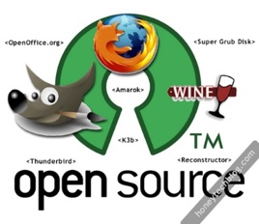

Leveraging the Crowd
“The World Wide Web became a tool for bringing together the small contributions of millions of people and making them matter”
Collaboration in large-scale

Slide 29
Pinto, Steinmacher, Dias and Gerosa, On the Challenges of Open-Sourcing Proprietary Software Projects, Empirical Software Engineering, 2018

Slide 30

All About Community!
OpenStack:
1.7M lines of code
19 programming languages
17K community members
5K+ code contributors
38K e-mail messages
Mozilla Firefox:
13.5M lines of code
37 programming languages
4K+ contributors (1K+ in the last 12 months)
4,231 years of effort (COCOMO model) - first commit in 2002
Swift:
445K lines of code
Over the past 12 months, 400+ developers
https://www.openhub.net/p/openstack
https://opensource.com/business/14/6/openstack-numbers
https://www.openhub.net/p/apple_swift

